Slide 1
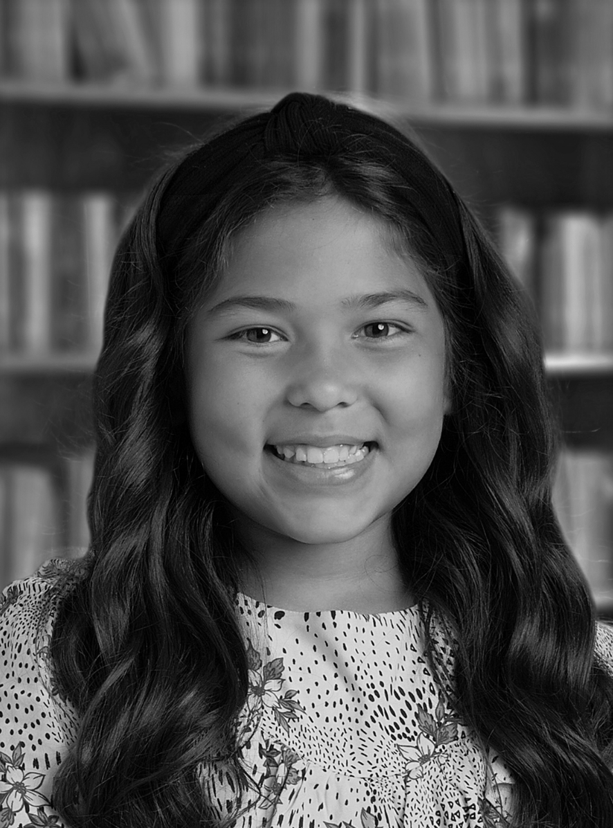

Parent Sign In
Email:
Password:
School Portrait Order Form
September 28-30 2021
Package Type | Description | Price
A | (2) 5x7, (4) 4x6, (4) wallets | $45
B | (4) 5x7, (6) 4x6, (8) wallets | $65
C | (1) 8x10,(2) 5x7, (4) 4x6, (16) wallets | $80
D | (3) 8x10,(4) 5x7, (4) 4x6, (16) wallets | $110
Add Digital Image | Digital Copies Included | $20
Digital Images Only | No physical images | $65
Picture Dates:
9/28: Grades 6-8
9/29: Grades 3-5
9/30: Grade K-2
Available in: Color or Black & White

Slide 2



Logged in: Welcome
Rebekah Dorn!
School Portrait Order Form
September 28-30 2021
Individual Child’s Name | Package(s) Selected
Child 1 | A ☐ Quantity ☐ B/W ☐ B ☐ Quantity ☐ B/W ☐ C ☐ Quantity ☐ B/W ☐ D ☐ Quantity ☐ B/W ☐ Digital ☐
Child 2 | A ☐ Quantity ☐ B/W ☐ B ☐ Quantity ☐ B/W ☐ C ☐ Quantity ☐ B/W ☐ D ☐ Quantity ☐ B/W ☐ Digital ☐
Total | $00.00
Group Names | Package(s) Selected
Child 1 + Child 2 | A ☐ Quantity ☐ B/W ☐ B ☐ Quantity ☐ B/W ☐ C ☐ Quantity ☐ B/W ☐ D ☐ Quantity ☐ B/W ☐ Digital ☐
Total | $00.00
Grand Total | $00.00

Slide 3
Logged in: Welcome
Rebekah Dorn!
School Portrait Order Form
September 28-30 2021
Individual Child’s Name | Package(s) Selected
Johnny Doe | A ☐ Quantity ☐ B/W ☐ B ☐ Quantity ☐ B/W ☐ C ☐ Quantity ☐ B/W ☐ D ☐ Quantity ☐ B/W ☐ Digital ☐
Sally Doe | A ☐ Quantity ☐ B/W ☐ B ☐ Quantity ☐ B/W ☐ C ☐ Quantity ☐ B/W ☐ D ☐ Quantity ☐ B/W ☐ Digital ☐
Total | $335.00
Group Names | Package(s) Selected
Johnny Doe + Sally Doe | A ☐ Quantity ☐ B/W ☐ B ☐ Quantity ☐ B/W ☐ C ☐ Quantity ☐ B/W ☐ D ☐ Quantity ☐ B/W ☐ Digital ☐
Total | $80.00
1
1
2
1
Grand Total | $415.00

Slide 4
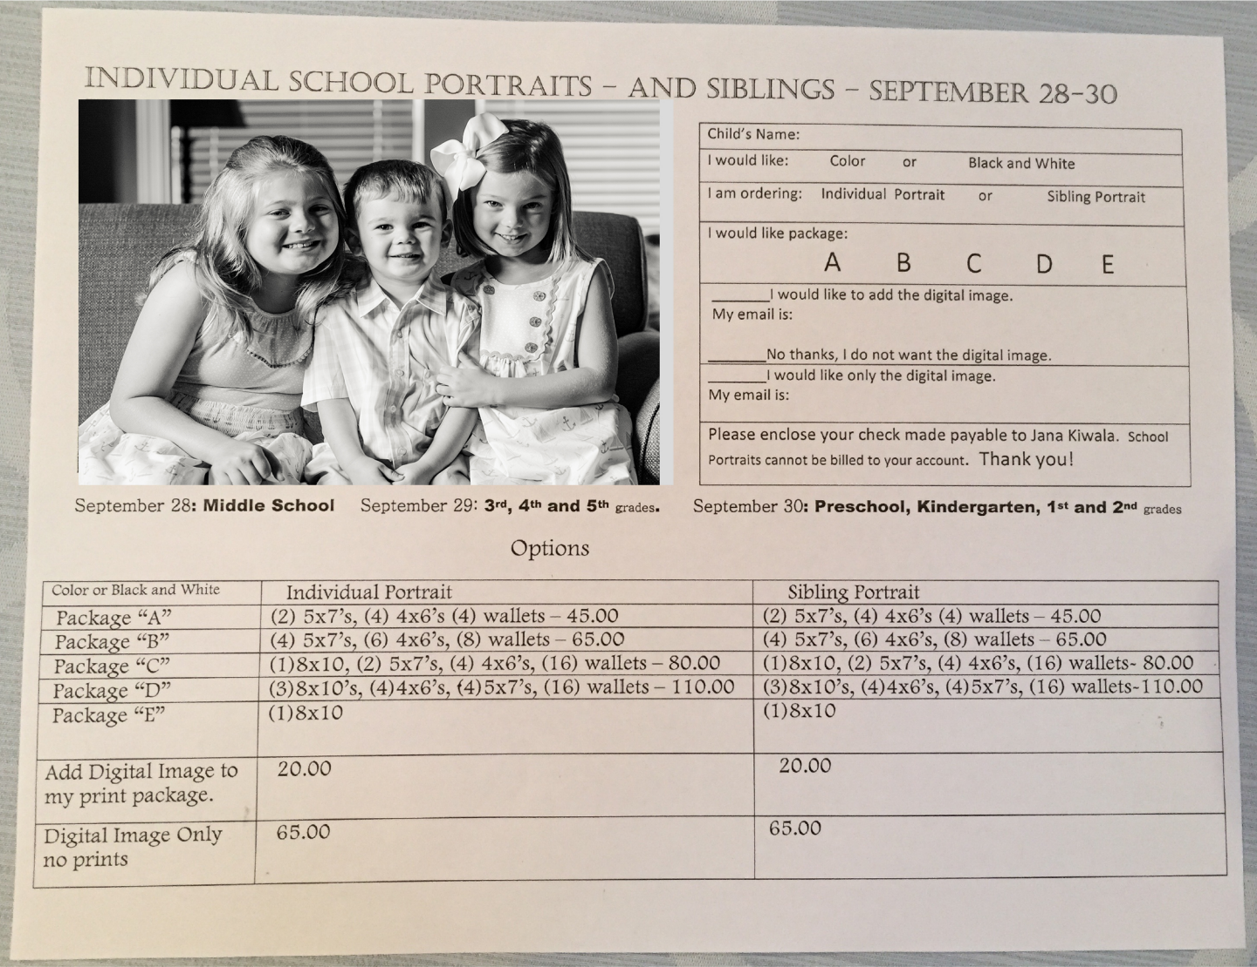
Old Form
Unofficial
Package options too wordy
Manual calculation
Parent verification

